Slide 1
Sign Language Gesture Identification using Masked R-CNN
Objective: Identify correct sign language gestures using Computer vision to improve the conditions that autistic individuals deal with on a day to day basis

Slide 2
Agenda
1
How has the journey been so far!!
2
Approach and Architecture
3
Step by Step Walk through – Our Journey
4
Results and Validation
5
Limitations and Way Forward

Slide 3
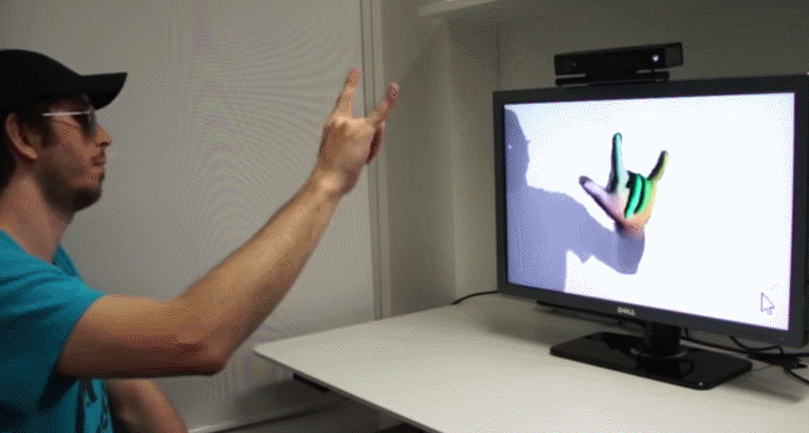
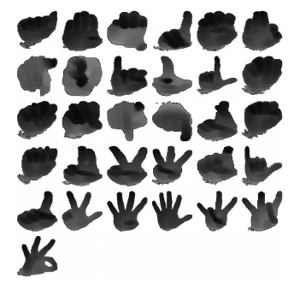
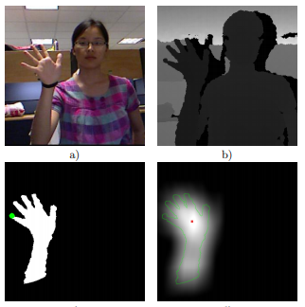
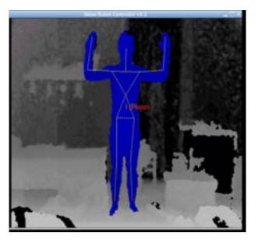
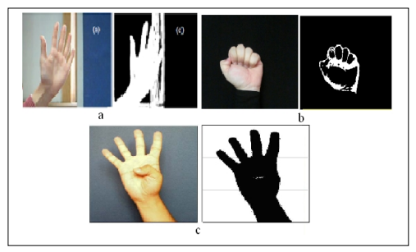
1
How has the journey been so far!!
Kinect - Depth Camera

Slide 4
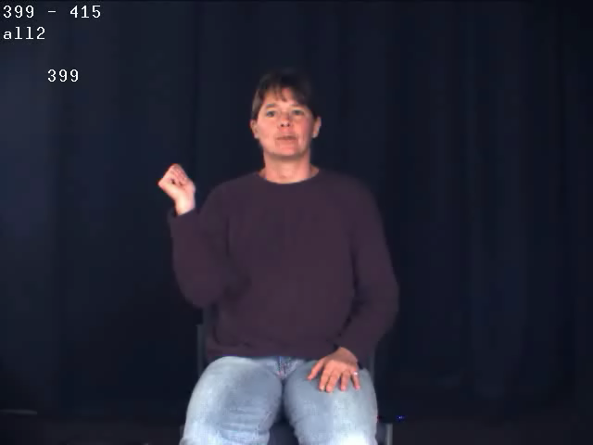
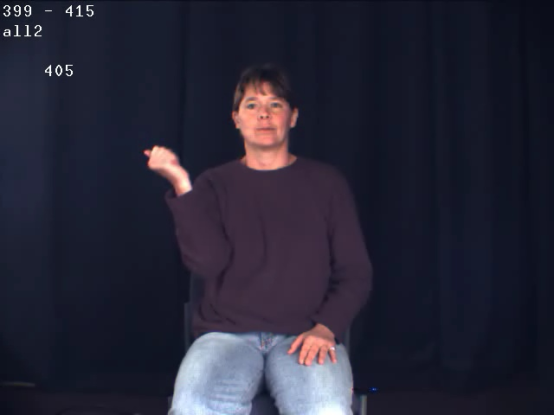
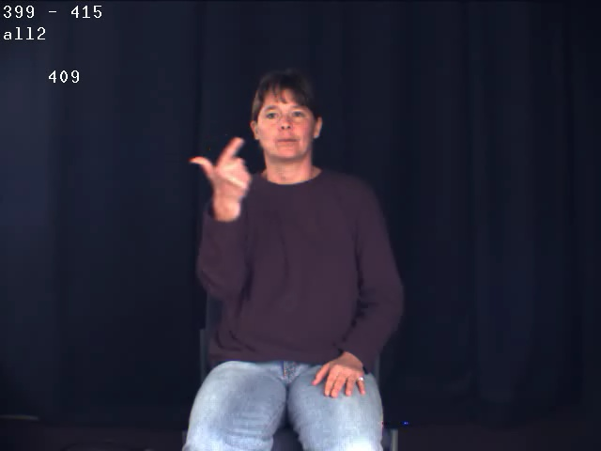
Step by Step Walk through – Our Journey
3
Step by Step Walk through – Our Journey
5
Key Frame Extraction
Gesture video:
Key Frame Extraction
Step 1: For each video frame k = 1 to N
Read frame Vk and Vk+1 and obtain the gray level image
Gk = Gray image of Vk
Gk +1 = Gray image of Vk +1
b. Find the edge difference between Gk and Gk + 1 using the Canny edge detector.
Let diff(k) be their difference.
dif(k) = summation of i,j (Gk - Gk + 1) where i, j are row and column index.
Step 2: Compute the mean (M) and standard deviation(S):
Step 3: Compute the threshold value
Threshold = M + a*S , where a = constant
Step 4: Find the key frames for k = 1 to (N-1)
If diff(k) > Threshold then, Write frame Vk +1 as the output key-frame.

Slide 5
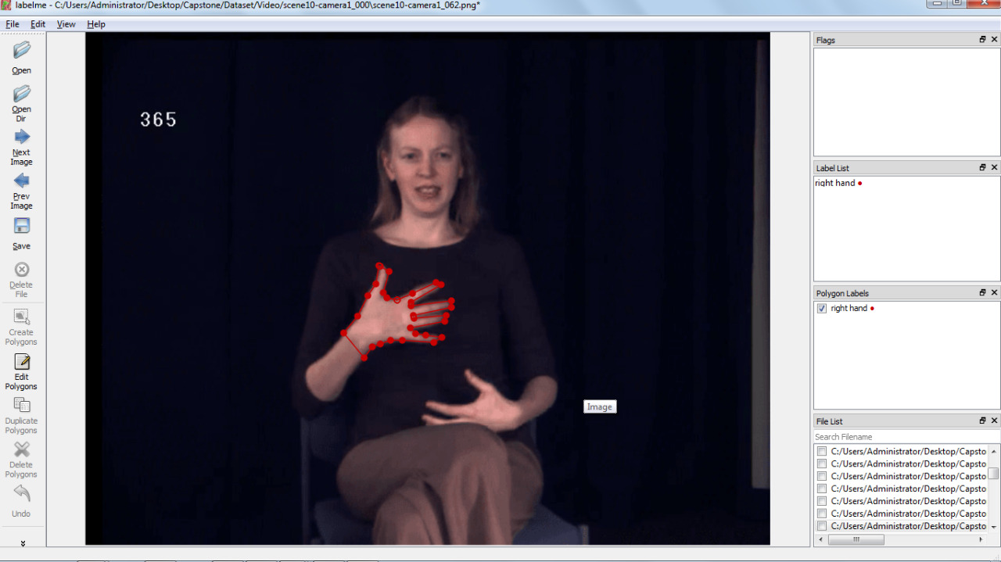
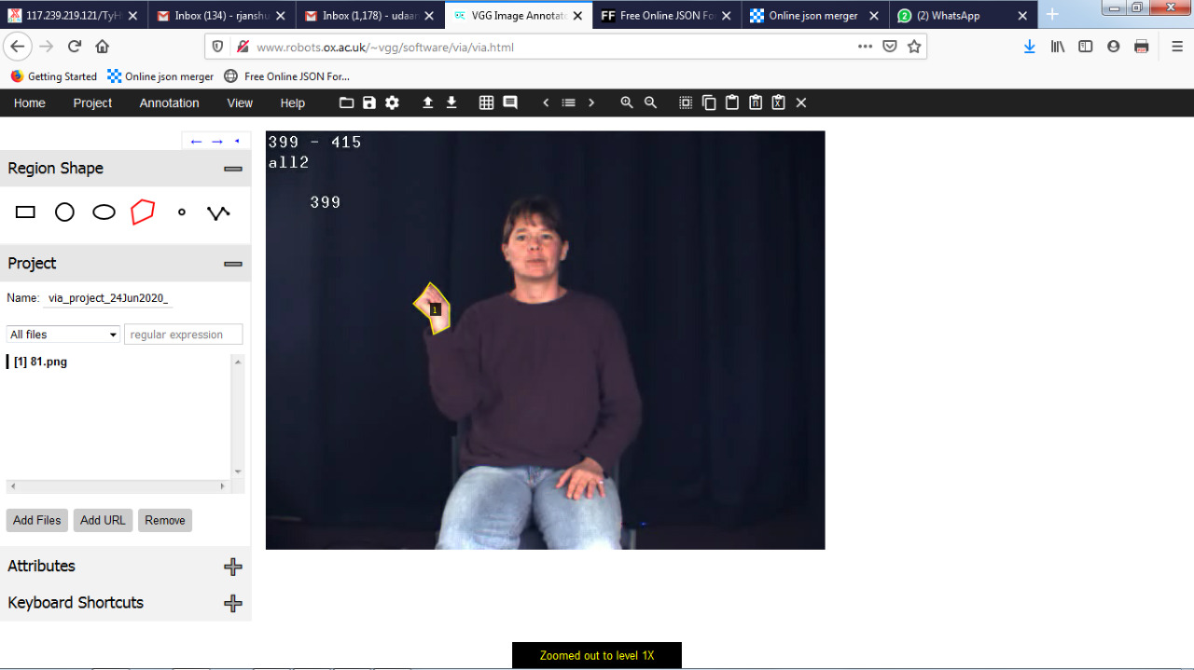
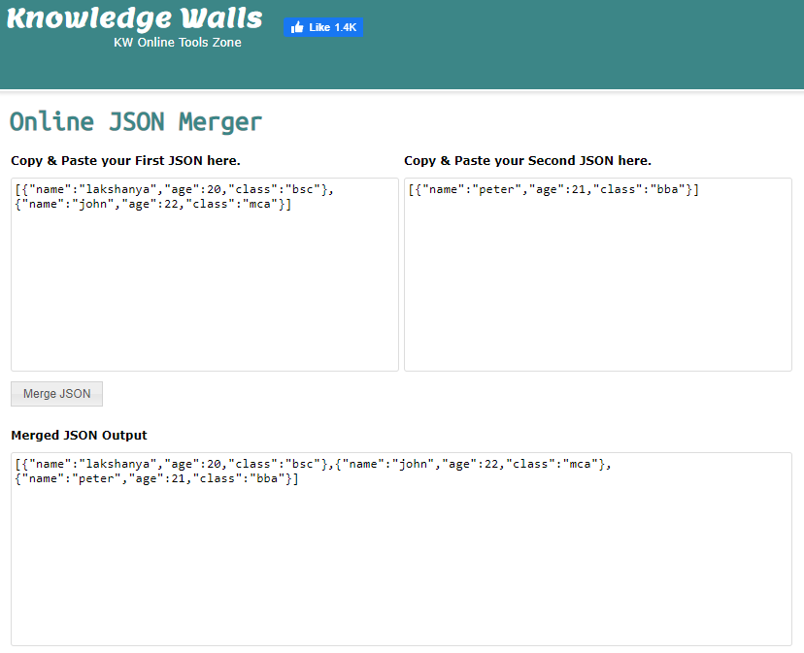
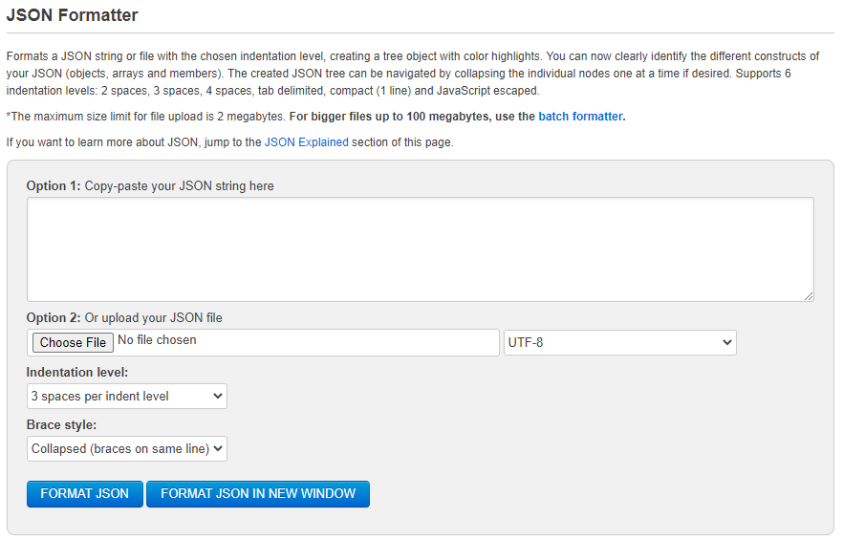
3
Step by Step Walk through – Our Journey
Polygon Creation - LabelMe
Polygon Creation – robots.ox.ac
Couldn’t get the coordinates and labels in the required format for input to Masked R-CNN framework
Leveraged www.robots.ox.ac.uk for polygon creation and its coordinates in Json file

Slide 6
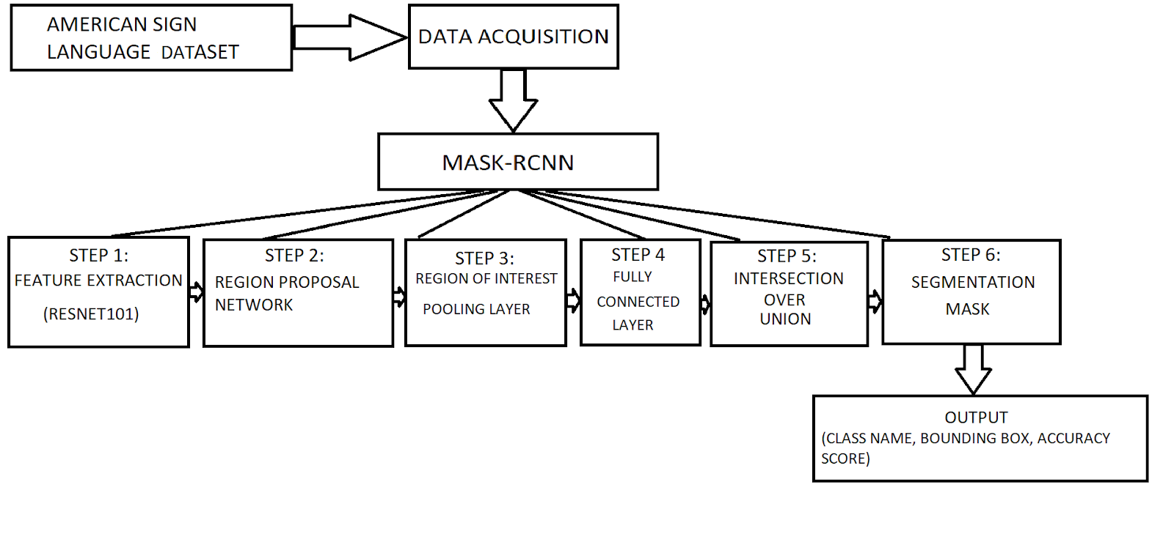
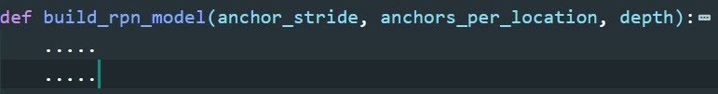
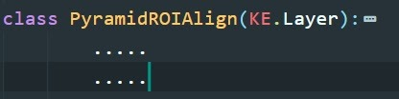
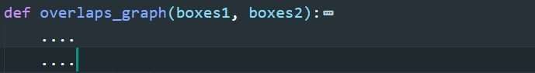
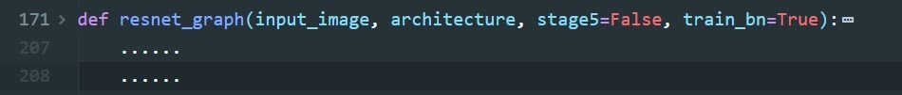
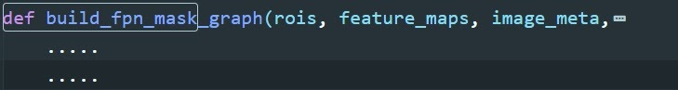
2
Approach and Architecture
Architecture
Region Proportion Network:
Region Proposal Network is basically used to determine whether a specific region has an object or not.
Region of Interest Pooling:
Region of Interest is found in order to extract even more richness to the existing image. Region of interest determines how an image can contain a specific region with more information in them.
Intersection over Union:
For all the predicted regions, we compute the intersection/union (intersection over union). Condition: If IoU is >= 0.5, then consider the region as ROI & if not, then exclude the region.
Approach
Feature Extraction:
The Resnet101 is a deep neural architecture with 101 blocks in it. Each block contains convolution layer, activation layer as Relu, again a convolution with a skip connection. ResNet solves the problem of vanishing gradients by using Skip connections in its architecture
Segmentation Mask:
Once the ROI is found wrt the IoU values, we must add a mask branch to existing architecture. This will give the segmentation mask for each region that contains an object (element wise segmentation).

Slide 7
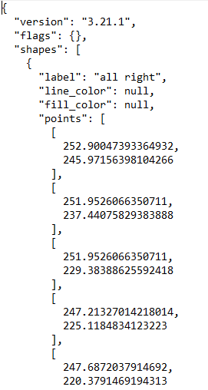
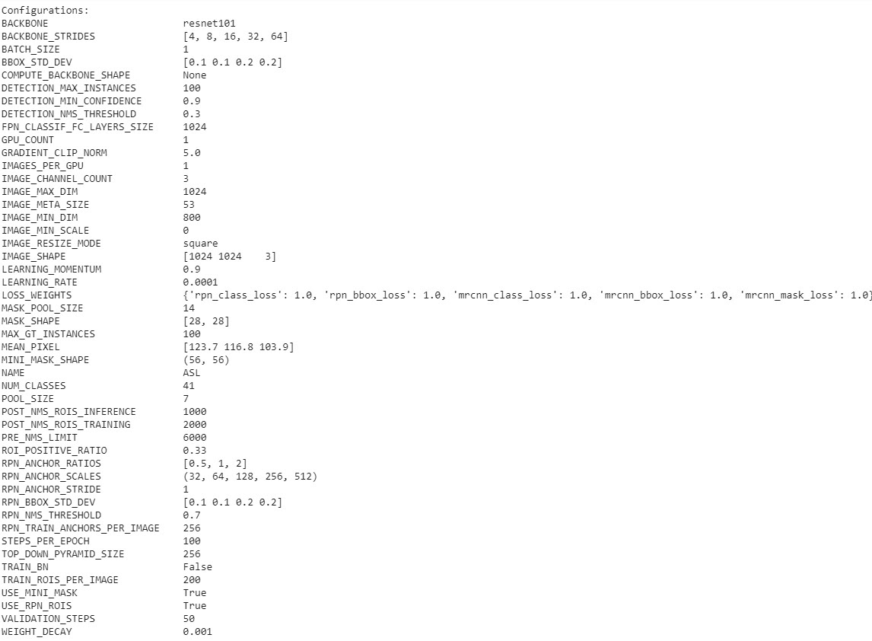
3
Step by Step Walk through – Our Journey
Final Json format : input to Masked R-CNN
Model - Parameters

Slide 8
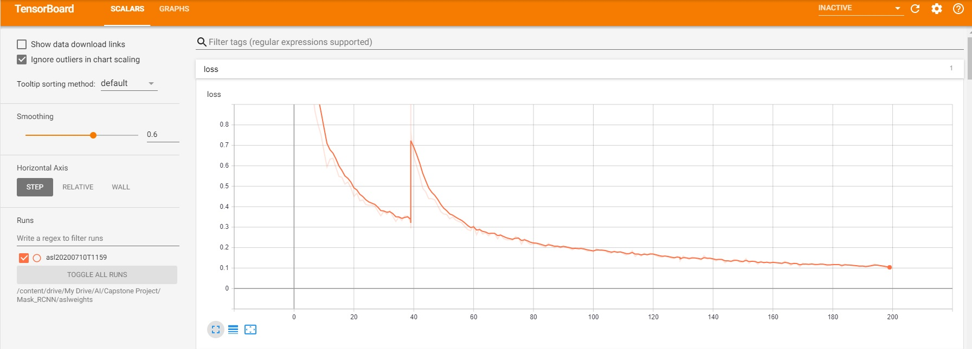
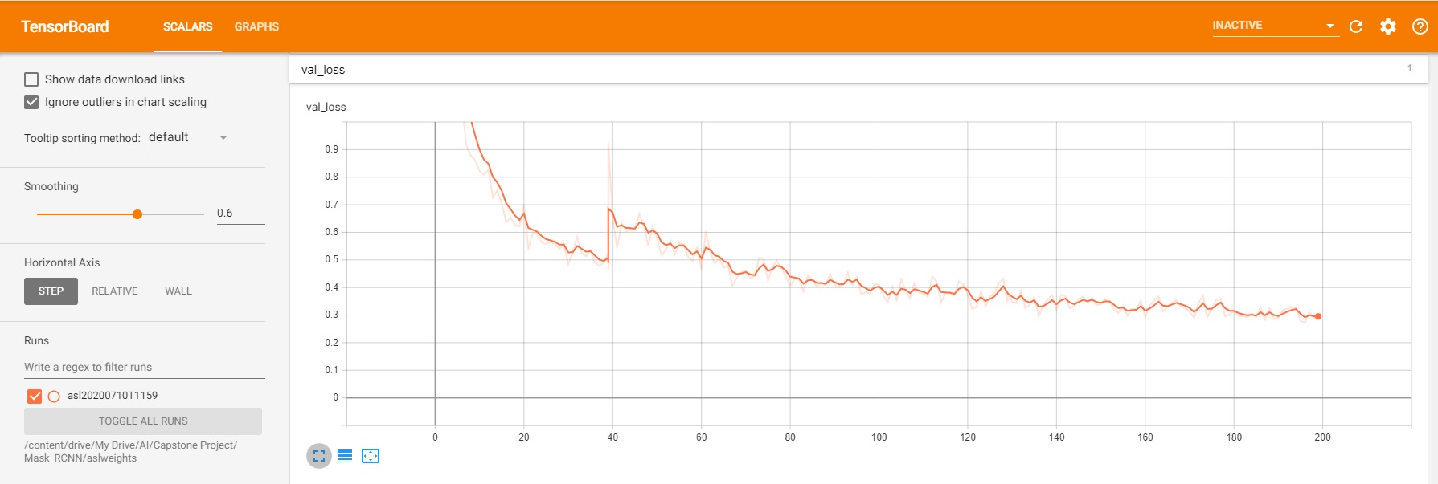
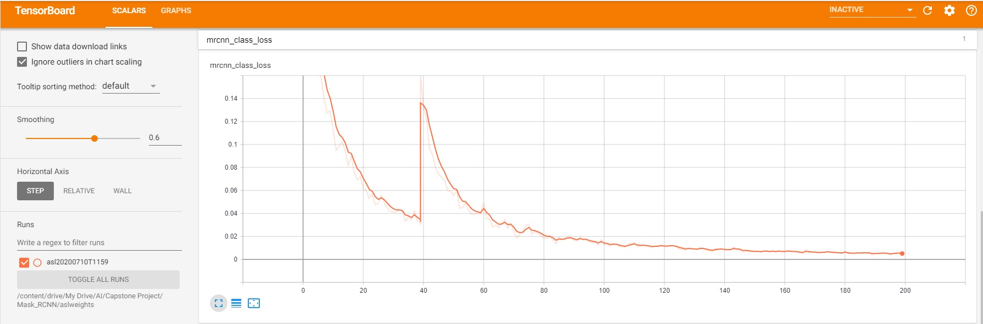
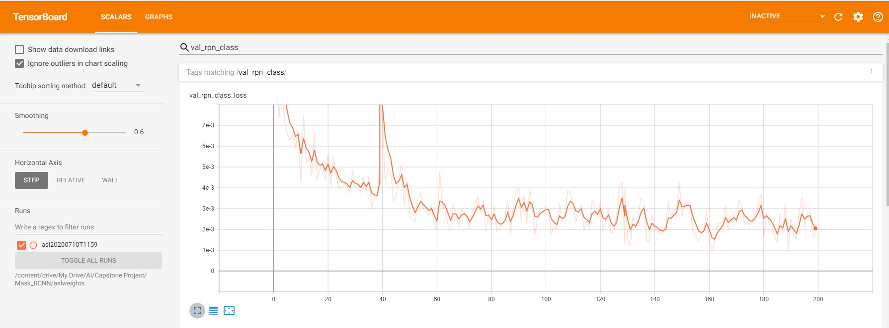
4
Results and Validation
Overall Testing Loss:
Overall Validation Loss:
Training: MRCNN Class Loss
Testing: MRCNN Class Loss

Slide 9
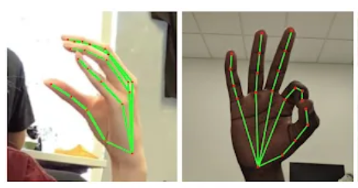
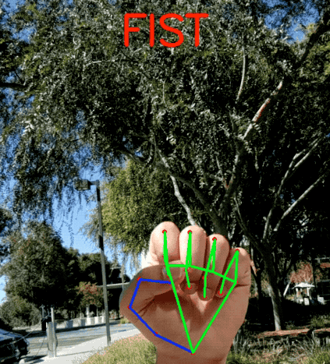
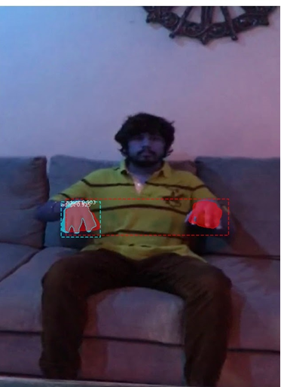
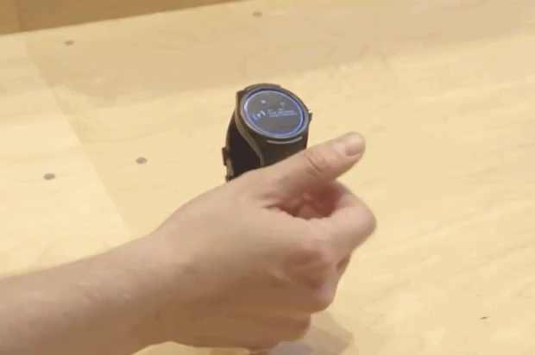
5
Limitations and Way Forward
Limitations
Way-forward
Model gets limited to what it sees
Since the model runs on a 1080x1920px resolution a lower GPU availability makes the training process slow
a
Hand-knuckle coordinates inside the detected hand regions
https://ai.googleblog.com/2019/08/on-device-real-time-hand-tracking-with.html
A heavy architecture makes it quite dependent on GPU even in Inference mode adding latency & a bit less compatible for real-time.
b
Control gadgets with touchless hand gestures

Slide 10
Thank You

Slide 11
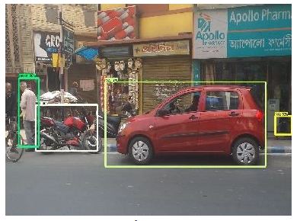
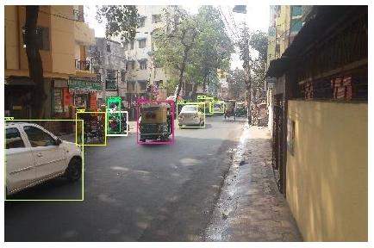
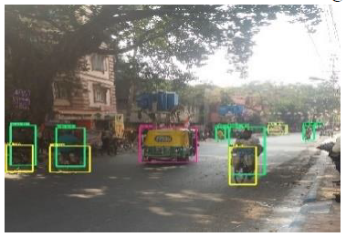
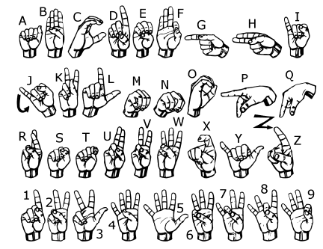
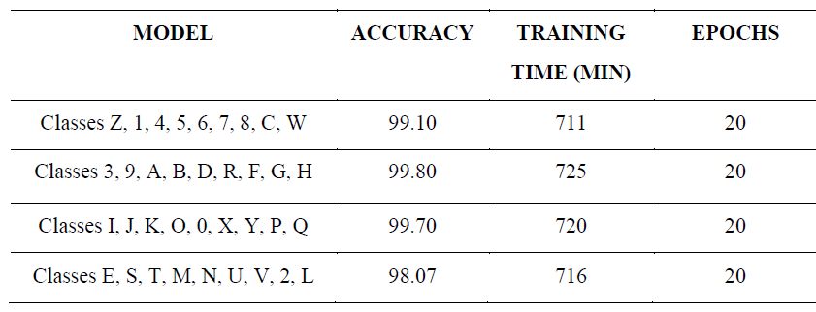
1
Current Scenario
Reached 99% accuracy on certain object detection – COCO dataset – 91 objects
Sign Language alphabet and numeric classification have reached 99% accuracy
Real Time Object Detection using Deep Learning: A Webcam Based Approach

Slide 12
Appendix

